Slide 1
Saving Model
Mahipal Singh

Slide 2
With joblib (preferred for large models like trees)
import joblib
# Step 1: Train model
# Step 2: Save the model
joblib.dump(model, 'rf_model.joblib')
# Step 3: Load it back
loaded_model = joblib.load('rf_model.joblib')

Slide 3
With pickle (generic Python serialization)
import pickle
# Save
with open('model.pkl', 'wb') as f:
pickle.dump(model, f)
# Load
with open('model.pkl', 'rb') as f:
loaded_model = pickle.load(f)

Slide 4

Using TensorFlow / Keras
Save entire model (architecture + weights + optimizer)
model.save('my_model.h5') # HDF5 format
# Load it back
from tensorflow.keras.models import load_model
model = load_model('my_model.h5')

Slide 5
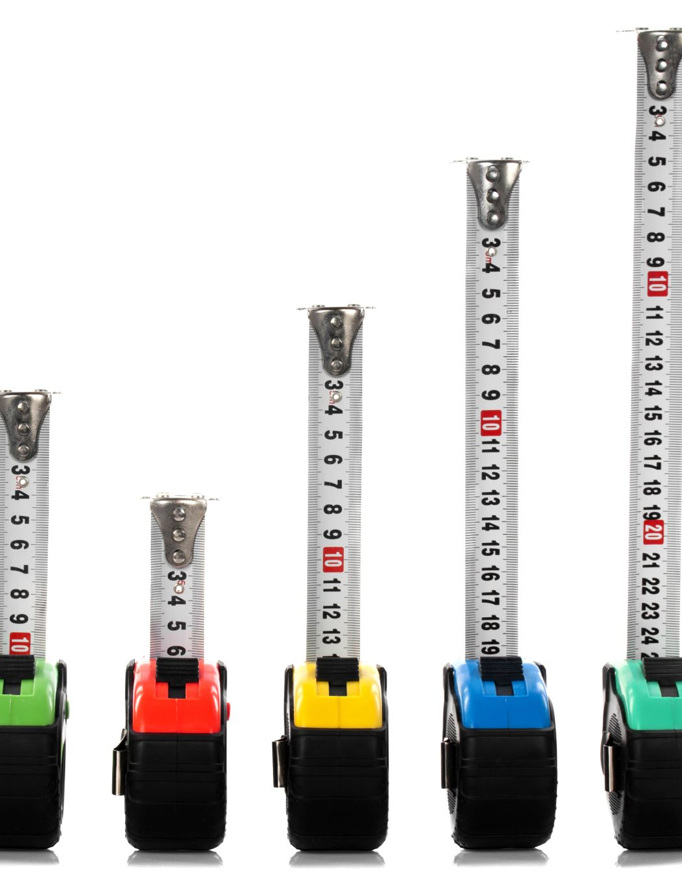
Using PyTorch
import torch
# Save the model state_dict
torch.save(model.state_dict(), 'model.pth')
# Load it back (recreate model architecture first)
model = TheModelClass(*args, **kwargs)
model.load_state_dict(torch.load('model.pth'))
model.eval()

Slide 6

Using XGBoost
import xgboost as xgb
# Train
model = xgb.XGBClassifier()
model.fit(X, y)
# Save to file
model.save_model('xgb_model.json')
# Load
loaded_model = xgb.XGBClassifier()
loaded_model.load_model('xgb_model.json')

